Slide 1
Quick Introduction to SBOL Visual 2.1
May 2019

Slide 2
Diagram Elements
Sequence Feature Glyphs
Molecular Species Glyph
Module
Nucleic Acid
Backbone
GFP
pTet
gfp
tetR
Interactions
Labels
Reverse Complement
Sequence Feature Glyphs
Interaction Node
aTc
Grey text and lines (including this) are annotations

Slide 3
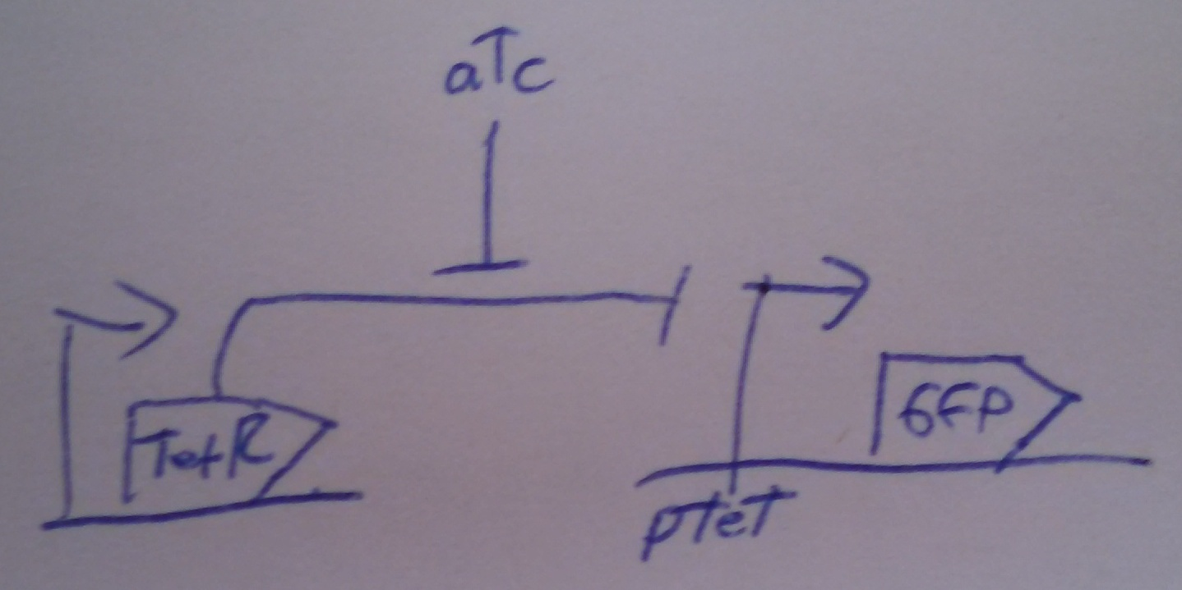
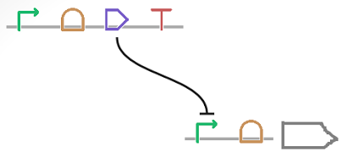
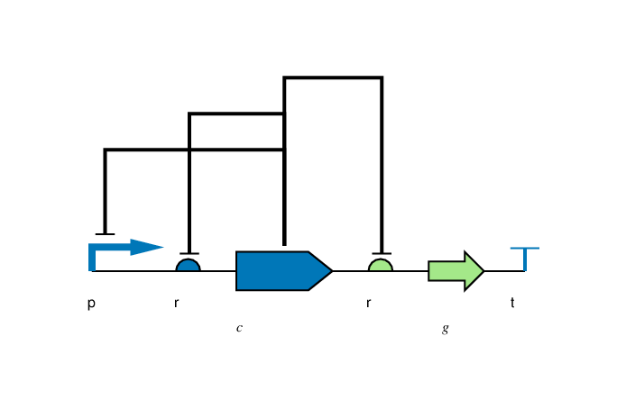
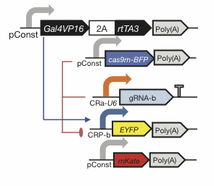
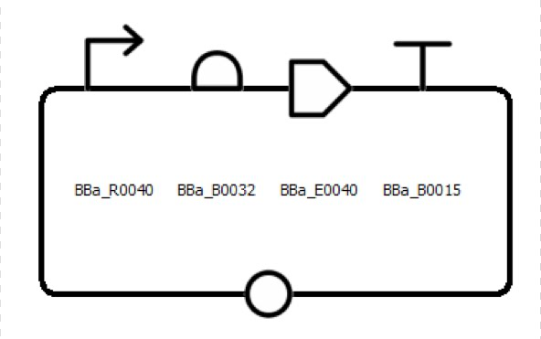
Flexibility of Style
Color, Text, Scaling, Strands, Styling: all your choice

Slide 4
Complex Example Diagram
tetr
J23101
TetR
∅
GFP
∅
gfp
pTet
The top functional unit produces the TetR protein constitutively, under control of promoter J23101. TetR represses the pTet promoter, which is regulating production of GFP. The diagram of GFP production explicitly includes the intermediate mRNA and the degradation of both the mRNA and protein products.

Slide 5
Nucleic Acid Glyphs

Slide 6
Molecular Species & Interaction Glyphs
Molecular Species
superpose glyphs
alternate
recommended alternate
Complex
Macromolecule
Protein
No Glyph
Nucleic Acid (Generic)
alternates
recommended alternate
Nucleic Acid (1-Strand)
Nucleic Acid (2-Strand)
Simple Chemical
Unspecified
Interaction
Control
Degradation
Inhibition
Process
Stimulation
Association
Dissociation
Process

Slide 7
Making SBOL Visual Diagrams
Using your favorite graphics editor:
Many glyphs can be drawn directly
Glyph set available: http://sbolstandard.org/visual/
Specialized visualization tools:
VisBOL: http://visbol.org/
GraphViz: http://www.graphviz.org/
DNAPlotLib: https://github.com/VoigtLab/dnaplotlib

Slide 8
Example: CRISPR Device

Slide 9
Example: CRISPR Circuit

Slide 10
Example: Rule 30 Circuit

Slide 11
Example: Pathway Engineering

Slide 12
Example: Genome Engineering

Slide 13
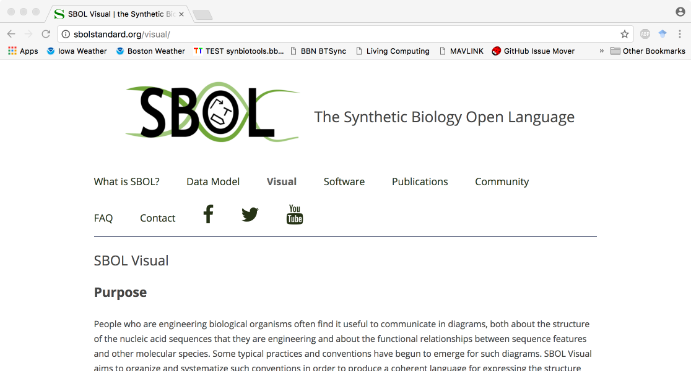
http://sbolstandard.org
Use the symbols in your papers & talks
Contribute opinions, use cases, new symbols
Community is open for anyone to join

